Slide 1
Welcome!

Slide 2
Opening Activity
Kid President: Pep Talk

Slide 3
Kid President charges us with being awesome. What (awesome) quality do you have that will contribute to success in your county?

Slide 4
IDPH Update

Slide 5
Project Update
Workstation website
Capacity and Planning training
NPN Conference funding amendment
Training schedule (via webinar)
Suicide prevention training and expectations
CLAS standards
Cross Site Evaluation

Slide 6
Project Team
Cheryl Davidson, Evaluator
Toby Yak, Epidemiologist
Pat McGovern, Iowa Youth Survey and Suicide Prevention Coordinator
Clare Jones, Training Consultant

Slide 7
Assessment Through Community Engagement

Slide 8
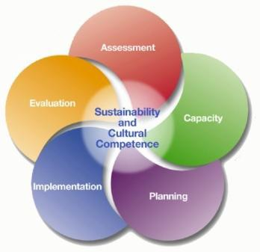

Slide 9
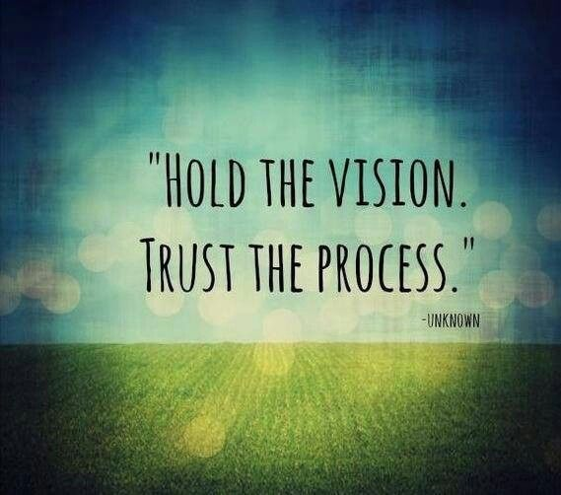

Slide 10
Building A Solid Foundation
Choosing And Implementing
Effective Strategies
Intervening Variables
Underlying Conditions
Assessment

Slide 11
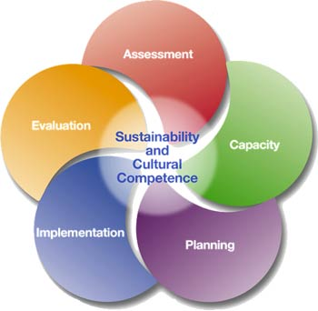
Iowa Partnerships for Success
County Assessment Workbook
2015
Iowa Department of Public Health
Division of Behavioral Health
Adapted from the Wyoming Epidemiological Workgroup and the North Dakota Strategic Prevention Framework State Incentive Grant Needs Assessment Workbook.

Slide 12
Products and Datelines
Table 1: Deadlines for Activities and Workbook Completion
Product | Due Date | Date Completed
Identify stakeholders to assist with data collection, interpretation and completion of Community Needs Assessment Workbook.
Identify needed data and determine if data is currently available or will need to be collected.
Collect data from existing sources.
Collect original data including law enforcement and stakeholder interviews, county meetings and focus groups
Identify current community resources. Identify possible gaps and areas of duplication.
Convene coalition, collaborative council or subcommittee to assist in review and completion of CAW.
County Needs Assessment Workbook submitted to IPDH

Slide 13
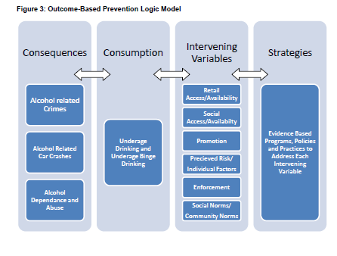

Slide 14
Workbook Organization
Organized into sections
Helps you in working through the process of assessing the need
More specifically:
Identify consumption and consequence patterns
Identify the intervening variables that are contributing to underage drinking and binge drinking
Setting priorities
Identifying existing community sources
Determining which intervening variables to address

Slide 15
Workbook Framework

Slide 16
Data sources
Pre-populated data:
Most of data around consequences and consumption available at the state level will be provided
Original Research:
Local data (county, city or community level data)
Interview, Town-hall, Focus groups meeting
Examples:
Consumption:
IYS, ABD
Consequences:
CJJP (convictions, arrests), DOE (student suspensions),
Intervening Variables
IYS (social norms, availability), ABD (availability), Focus group (social norms), Environmental Scans (billboard, newspapers)

Slide 17
County Description
Describe your county demographic specificities
age distribution, gender, race, SES, etc.
Include Map
Other information that will show how unique your county is

Slide 18
Alcohol-Related Consequences Data
Crimes:
Youth alcohol violations, OWI charges: Number and rate per 10,000
Alcohol related crashes
% drivers involved in Fatal crashed
Alcohol school expulsion and suspensions
Answer questions comparing your county vs. state.
Interpret results

Slide 19
Consumption Data
Student underage drinking: past month, binge drinking
IYS
Discussion

Slide 20
Intervening Variables
Alcohol availability
Per capital liquor licenses and gallons sales; Compliance check failure rates; Percent drive-up liquor sales; local ordinance;
Retail availability: impact scale
Police/Sheriff Interviews
Social availability
Easy access to alcohol in community; focus group;
Social availability impact scale;

Slide 21
Intervening Variables (cont.)
Promotion
Sponsorships of major events (census %); advertising (% billboards, local newspapers);
Promotion impact scale
County norms
Student core values (% social norms, peers values, adult neighbors and parents); alcohol temporary licenses; county meetings (Focus Group)

Slide 22
Intervening Variables (cont.)
Individual factors:
Alcohol constructs (perception, sensation seeking, parent attitudes); graduation rates
Individual factors impact scale

Slide 23
Prioritization
Setting priorities
Using impact scores, rank each Intervening Variable with 1 being the highest priority (variable with the highest score) and 6 the lowest
Justify Prioritization of the Intervening Variables

Slide 24
Resource Assessment
Current Resources and Strategies Focusing Upon the Underage and Binge Drinking by Intervening Variable
Intervening Variable | Strategies | Resources
Retail Availability
Social Availability
Promotion
County Norms
Individual Factors

Slide 25
Appendices
Law enforcement interview protocol
Goal collect valuable data
Choose good interviewees
Interview notebook
County meeting or Focus groups
Moderator
Choosing participants
Conducting the discussion

Slide 26
Sharing Lessons Learned
Thinking back to conducting a community assessment through SPF SIG, DFC, or another project, discuss at your table:
What do you wish you had known then that you know now? What will you do differently this time?
What was your biggest challenge?
What was your biggest success?
What is the most important thing to remember?

Slide 27
Assessing Community Readiness
Readiness is the degree to which a community is prepared to take action on an issue.
It is an essential piece in
creating community change

Slide 28
The Tri-Ethnic Community Readiness Model
Tri-Ethnic Center for Prevention Research
Sage Hall, Colorado State University
www.TriEthnicCenter.ColoState.edu
Insert here links for IDPH resources and deliverables

Slide 29
Dimensions of Readiness
A
Community Efforts
B
C
Leadership
D
E
Community Knowledge About The Issue
F
Community Knowledge Of The Efforts
Community Climate
Resources Related To The Issue

Slide 30
Stages of Readiness
9.
High Level of Community Ownership
8.
Confirmation/Expansion
7.
Stabilization
6.
Initiation
5.
Preparation
4.
Preplanning
3.
Vague Awareness
2.
Denial
1.
No Awareness

Slide 31
Community Readiness
Define “Community”
Conduct Key Respondent Interviews
Score to determine readiness level
Develop readiness strategies
COMMUNITY CHANGE!

Slide 32
Sharing Lessons Learned
Thinking back to conducting community readiness through SPF SIG, DFC, or another project, discuss at your table:
What do you wish you had known then that you know now? What will you do differently this time?
What was your biggest challenge?
What was your biggest success?
What is the most important thing to remember?

Slide 33
Getting It Done
“You can’t do good prevention from ________________________.”

Slide 34
What does “engagement” mean?
What does engagement look like?
How can we make it happen?

Slide 35
International Association for Public Participation: Spectrum of Public Participation
Inform
Consult
Involve
Collaborate
Empower
Increasing Level of Public Impact
http://c.ymcdn.com/sites/www.iap2.org/resource/resmgr/imported/IAP2%20Spectrum_vertical.pdf

Slide 36
Putting It All Together

Slide 37
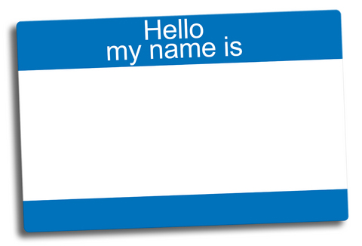
Share your name and county and
“If you could go anywhere on vacation, where would you go?”

Slide 38
Don’t forget your chance to sign up for a time to meet with Julie!

Slide 39
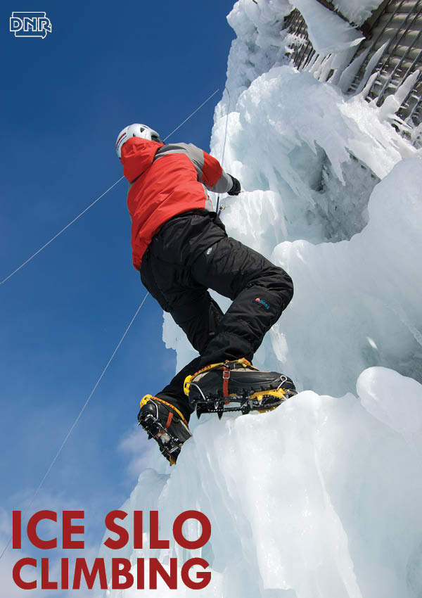
Share your name and county and
“What is your favorite activity to do locally?”

Slide 40
CAPT Training

Slide 41
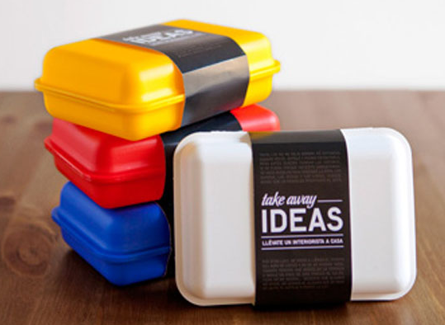
Share your name and county and
“One thing your are taking away from today’s training.”

Slide 42
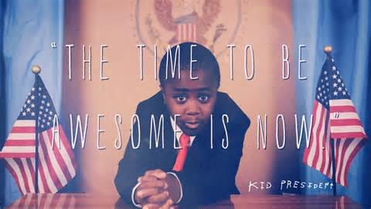
Closing

Slide 43
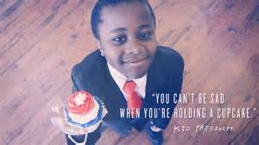
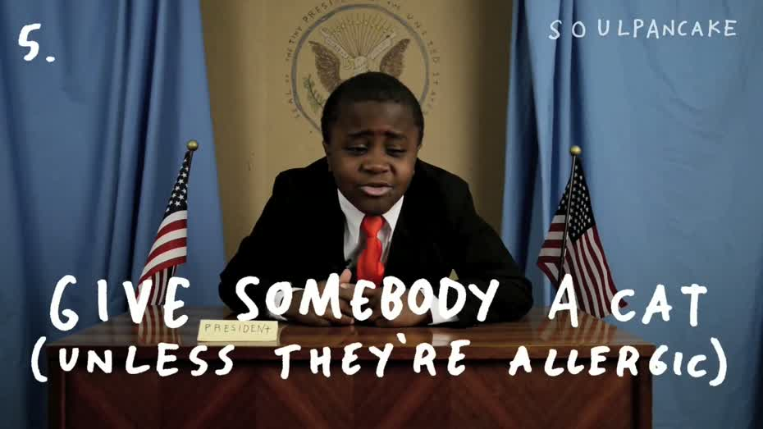
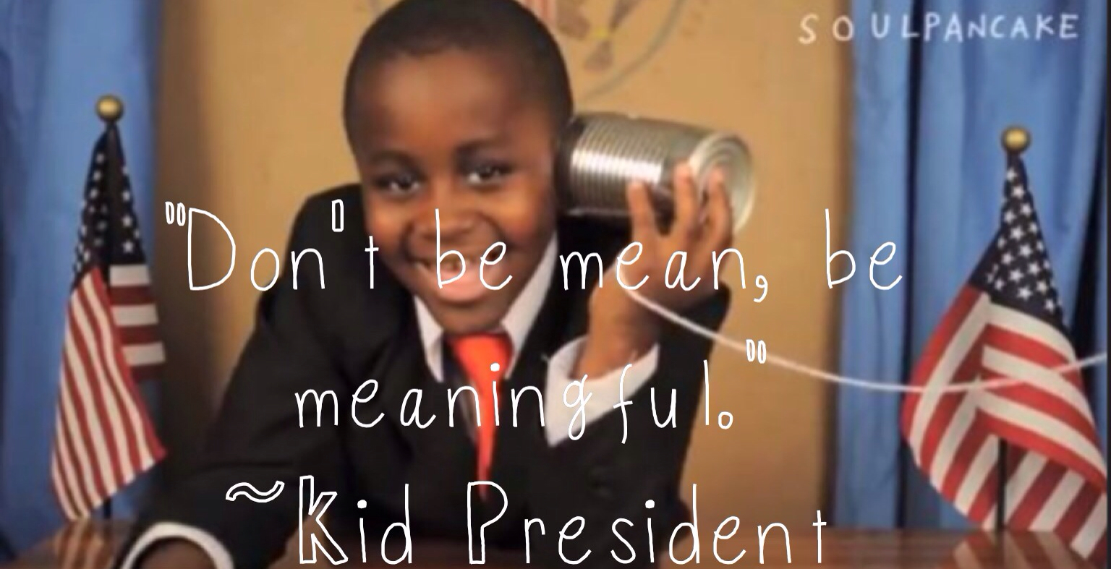
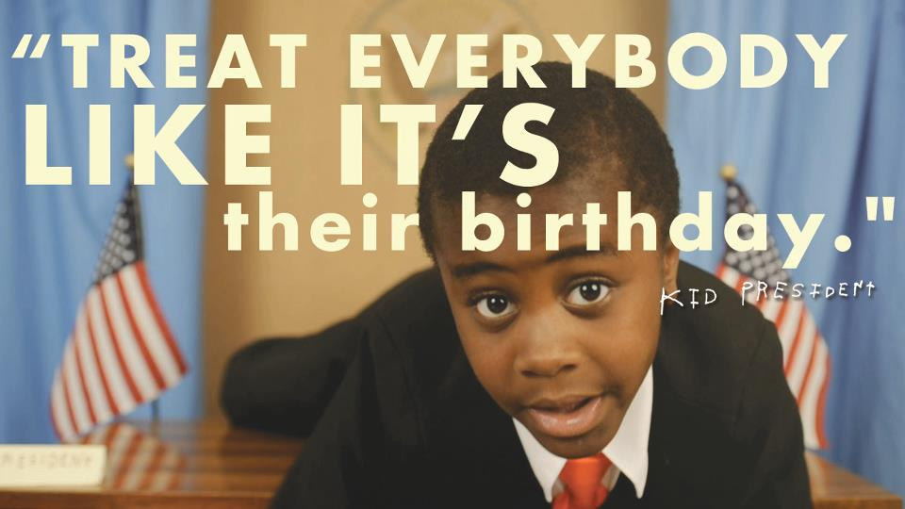
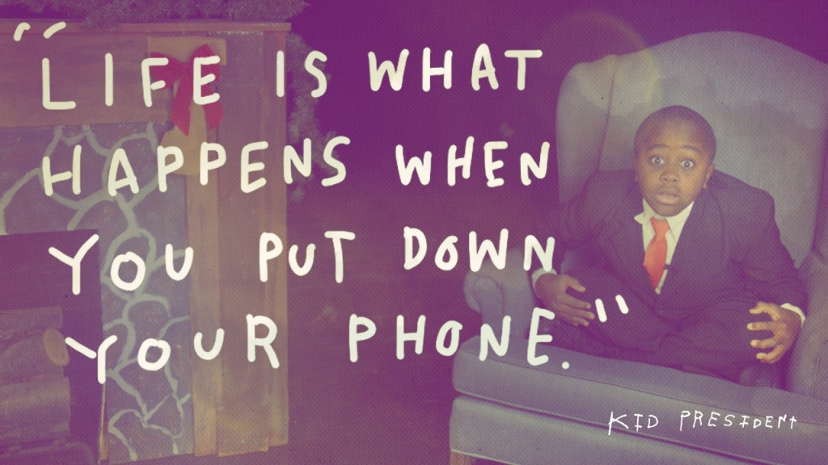
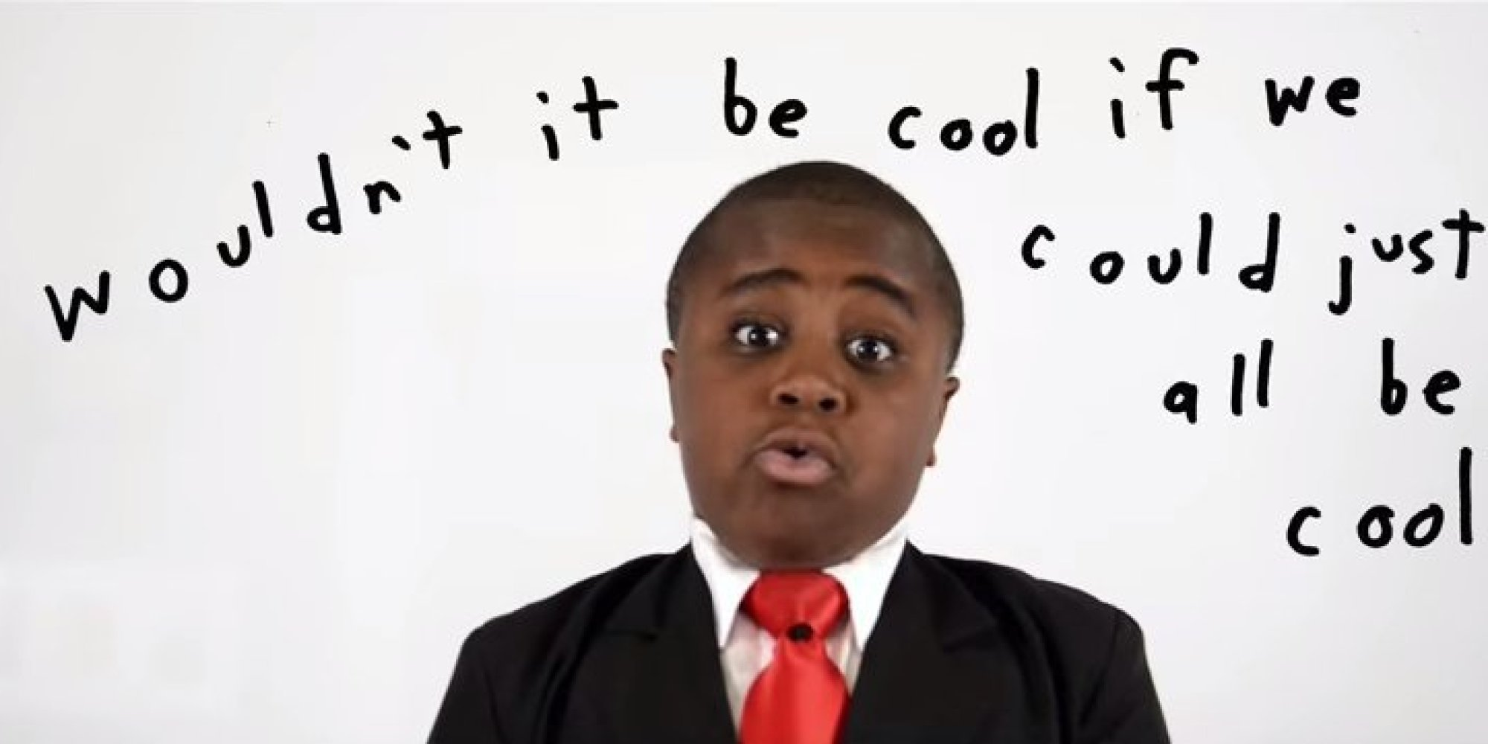
A Little Wisdom From Kid President To Leave You With….

